Slide 1
Sequential Circuits
Part 4

Slide 2
STATE DIAGRAM TO SEQUENTIAL CIRCUIT

Slide 3
State Diagram to Sequential Circuit
We can describe behavior of a sequential circuits using two methods:
State Table
State Diagram

Slide 4
State Diagram to Sequential Circuit
0/0
State Diagram
Showing circuit behavior
input/output
x/y
00
1/1
1/0
1/0
01
10
0/1
0/0
0/0
11
1/0

Slide 5
State Diagram to Sequential Circuit
State Table
Based on the state diagram (vice versa is also possible)
Present State
Next State
X=0
X=1
X=0
X=1
QA | QB | QA+ | QB+ | QA+ | QB+ | y | y
0 | 0 | 0 | 0 | 0 | 1 | 0 | 0
0 | 1 | 1 | 1 | 0 | 1 | 0 | 0
1 | 0 | 1 | 0 | 0 | 0 | 1 | 1
1 | 1 | 1 | 0 | 1 | 1 | 0 | 0

Slide 6
State Diagram to Sequential Circuit
Circuit Excitation Table – we chose T flip flops here for both the states
QA | QB | x | QA+ | QB+ | Ta | Tb | y
0 | 0 | 0 | 0 | 0 |  |  | 0
0 | 0 | 1 | 0 | 1 |  |  | 0
0 | 1 | 0 | 1 | 1 |  |  | 0
0 | 1 | 1 | 0 | 1 |  |  | 0
1 | 0 | 0 | 1 | 0 |  |  | 1
1 | 0 | 1 | 0 | 0 |  |  | 1
1 | 1 | 0 | 1 | 0 |  |  | 0
1 | 1 | 1 | 1 | 1 |  |  | 0

Slide 7
State Diagram to Sequential Circuit
Flip Flop and Output Equation
In this case we will get 3 equations:
Ta
Tb
y
Ta = ?
Tb= ?
y = ?

Slide 8
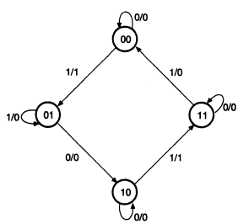
Example State Diagram

Slide 9
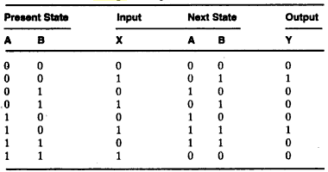
State Assignment

Slide 10
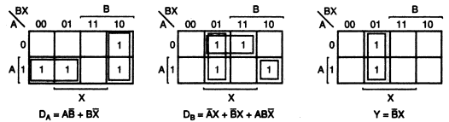

Input Equation: K-Map or Directly

Slide 11
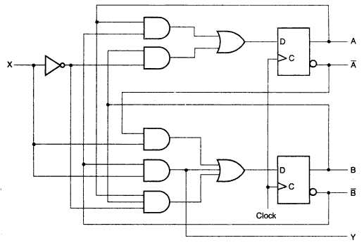
Logic Diagram Using D Flip-flops

Slide 12
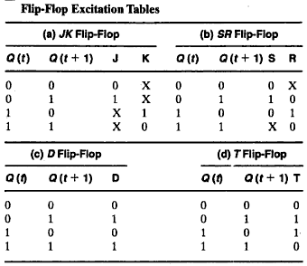
Flip-flop Exciting Tables

Slide 13
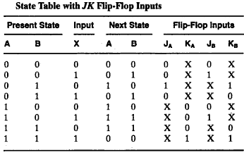
Design With JK Flip-flops

Slide 14
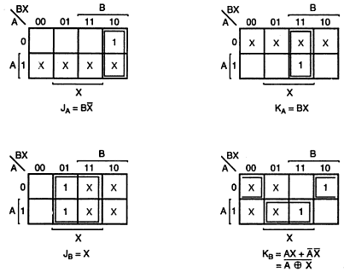
Design With JK Flip-flops

Slide 15
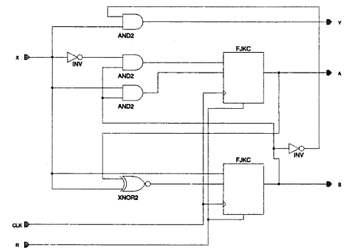
Design With JK Flip-flops

Slide 16
Thank You

